Slide 1

Understanding VPN Technology: From Zero to Hero
Mhd Zaid Al Nahhas
9 / 9 / 2024

Slide 2
What is a VPN?
• A Virtual Private Network (VPN) creates a secure, encrypted connection between your device and a VPN server.
• It allows you to browse the internet with increased privacy and security, masking your IP address.

Slide 3
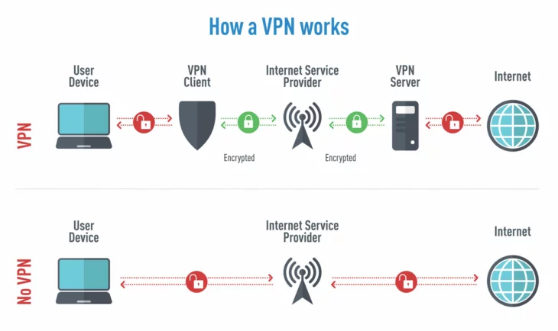

Slide 4
How the Internet Works Without VPN
• Devices connect to the internet through the Internet Service Provider (ISP).
• ISPs assign public IP addresses and route data to the global internet.
• Data travels unencrypted, and the ISP can monitor your activities.

Slide 5
Why Use a VPN?
• Security: Encrypts data, protecting sensitive information (e.g., passwords, financial transactions).
• Bypass Geo-Restrictions: Access content not available in your location.
• Avoid Censorship: Circumvent governmental or institutional content blocks.
• Public Wi-Fi Protection: Ensures your data is safe from hackers on unsecured networks.

Slide 6
The Role of IP Addresses
• Public IP addresses are routable and visible to websites and other services.
• Private IP addresses are used within local networks, converted to public IPs through NAT (Network Address Translation).
• ISPs buy blocks of IP addresses from regional internet registries like IANA and distribute them to their customers.

Slide 7
Step-by-Step VPN Process
1. Device connects to the VPN server using encryption.
2. All internet traffic is routed through the VPN tunnel.
3. VPN server decrypts the data and forwards it to the destination.
4. The website sees the VPN server’s IP address, not yours.

Slide 8


Slide 9
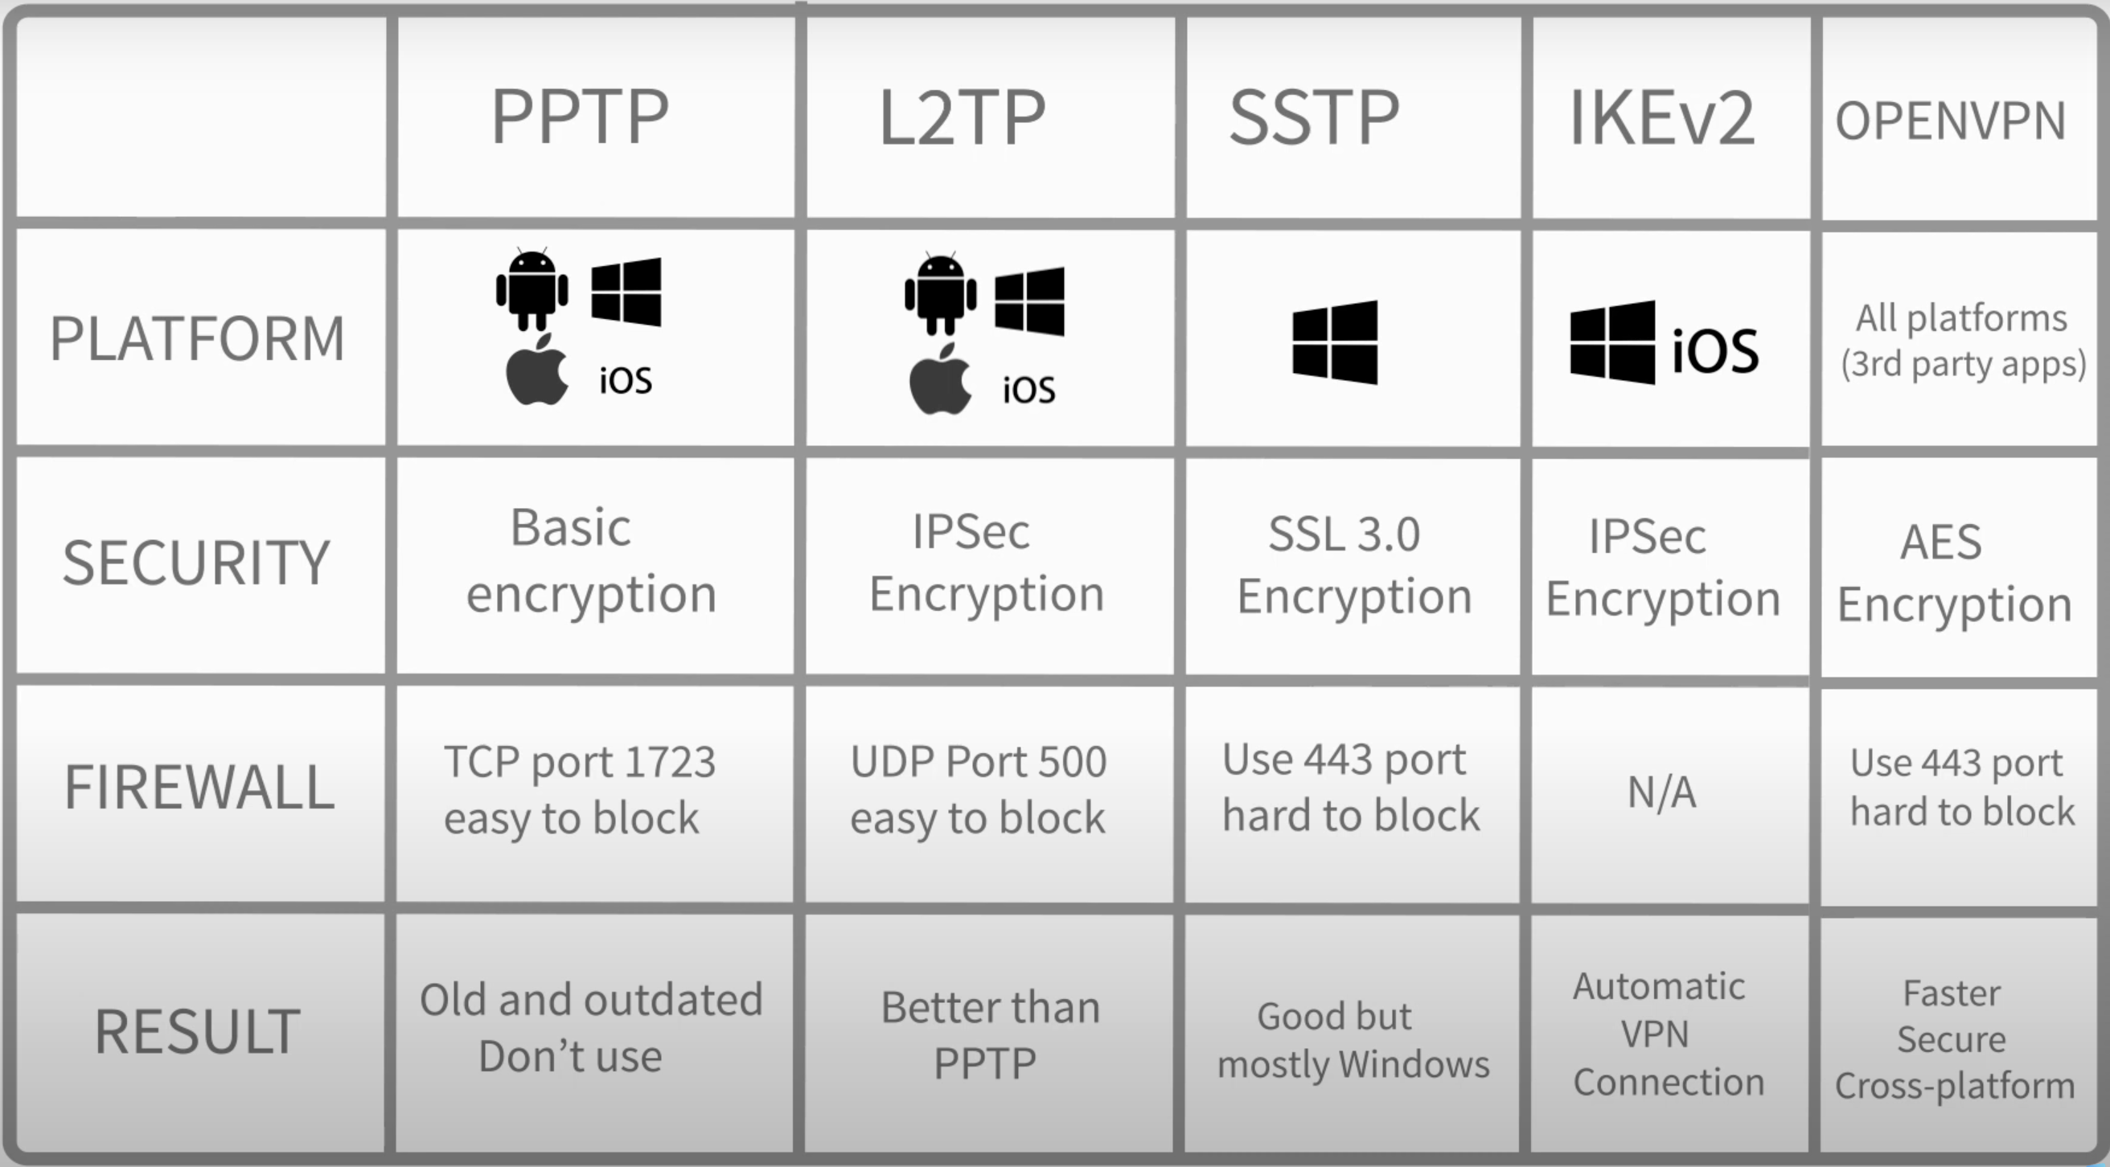

Slide 10
Limitations of VPNs
VPNs protect privacy but do not provide complete anonymity.
• Speed reduction due to encryption overhead.
• Websites blocking VPN IPs.
• VPN provider logging policies (choosing a no-log provider is essential).

Slide 11
Can ISPs Decrypt VPN Traffic?
ISPs cannot decrypt VPN traffic due to strong encryption algorithms like AES-256.
• They may detect VPN traffic, but the data remains unreadable.

Slide 12
How ISPs Detect VPN Traffic
• Known VPN IP address databases.
• Deep Packet Inspection (DPI) to detect encryption patterns.
• Protocol identification, e.g., OpenVPN or WireGuard.

